Slide 1

Slide 8- <number>

Slide 2
Chapter 6
SQL-99: Basic SQL
Copyright © 2007 Ramez Elmasri and Shamkant B. Navathe

Slide 3
SQL
The name SQL is presently expanded as Structured Query Language was designed and implemented at IBM Research as the interface for an experimental relational database system called SYSTEM R.
SQL is a comprehensive database language: It has statements for data definitions, queries, and updates. Hence, it is both a DDL and a DML.

Slide 4
SQL Data Definition and Data Types
6.1.1 Schema and Catalog Concepts in SQL
CREATE SCHEMA COMPANY AUTHORIZATION ‘Jsmith’;

Slide 5
SQL Data Definition and Data Types
6.1.2 The CREATE TABLE Command in SQL
The CREATE TABLE command is used to specify a new relation by giving it a name and specifying its attributes and initial constraints.
The attributes are specified first, and each attribute is given a name, a data type to specify its domain of values, and possibly attribute constraints, such as NOT NULL.
The key, entity integrity, and referential integrity constraints can be specified within the CREATE TABLE statement after the attributes are declared
CREATE TABLE EMPLOYEE

Slide 6
SQL Data Definition and Data Types
6.1.2 The CREATE TABLE Command in SQL
The CREATE TABLE command is used to specify a new relation by giving it a name and specifying its attributes and initial constraints.
The attributes are specified first, and each attribute is given a name, a data type such as (INTEGER, FLOAT, DECIMAL(i,j), CHAR(n), VARCHAR(n)) to specify its domain of values, and possibly attribute constraints, such as NOT NULL.
The key, entity integrity, and referential integrity constraints can be specified within the CREATE TABLE statement after the attributes are declared
CREATE TABLE EMPLOYEE

Slide 7
CREATE TABLE
CREATE TABLE DEPARTMENT (
DNAME VARCHAR(10) NOT NULL,
DNUMBER INTEGER NOT NULL,
MGRSSN CHAR(9),
MGRSTARTDATE CHAR(9) );

Slide 8
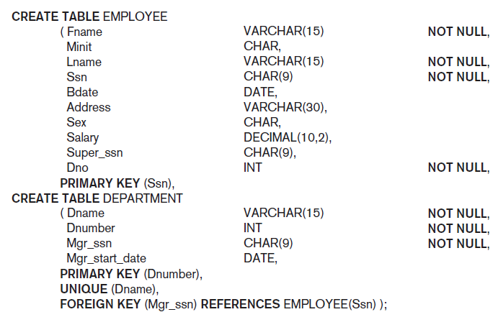
CREATE TABLE

Slide 9
CREATE TABLE
In SQL2, can use the CREATE TABLE command for specifying the primary key attributes, secondary keys, and referential integrity constraints (foreign keys).
Key attributes can be specified via the PRIMARY KEY and UNIQUE phrases
  CREATE TABLE DEPT (
  DNAME VARCHAR(10) NOT NULL,
  DNUMBER INTEGER NOT NULL,
  MGRSSN CHAR(9),
  MGRSTARTDATE CHAR(9),
  PRIMARY KEY (DNUMBER),
  UNIQUE (DNAME),
  FOREIGN KEY (MGRSSN) REFERENCES EMP );

Slide 10
6.1.3 Attribute Data Types
The basic data types available for attributes include numeric, character string, bit string, Boolean, date, and time.
Numeric: Numeric data types include integer numbers of various sizes (INTEGER or INT, and SMALLINT) and floating-point (real) numbers of various precision (FLOAT or REAL, and DOUBLE PRECISION).
Formatted numbers can be declared by using DECIMAL(i, j)—or DEC(i, j) or NUMERIC(i, j)—where i, the precision, is the total number of decimal digits and j, the scale, is the number of digits after the decimal point.

Slide 11
6.1.3 Attribute Data Types
Character-string: Character-string data types are either fixed length—CHAR(n) or CHARACTER(n), where n is the number of characters - or varying length -
VARCHAR(n) or CHAR VARYING(n) or CHARACTER VARYING(n), where n is the maximum number of characters.
Bit-string: Bit - string data types are either of fixed length n - BIT(n) - or varying length - BIT VARYING(n), where n is the maximum number of bits.
Boolean: A Boolean data type has the traditional values of TRUE or FALSE. In SQL, because of the presence of NULL values, a three-valued logic is used, so a third possible value for a Boolean data type is UNKNOWN.

Slide 12
6.1.3 Attribute Data Types
DATE & TIME: The DATE data type has ten positions, and its components are YEAR, MONTH, and DAY in the form YYYY-MM-DD.
The TIME data type has at least eight positions, with the components HOUR, MINUTE, and SECOND in the form HH:MM:SS. Only valid dates and times should be allowed by the SQL implementation.
TIMESTAMP: A timestamp data type (TIMESTAMP) includes the DATE and TIME fields, plus a minimum of six positions for decimal fractions of seconds and an optional WITH TIME ZONE qualifier.

Slide 13
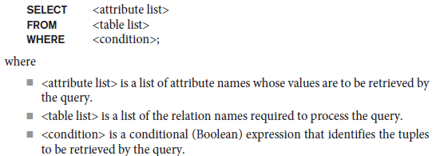
SELECT Statement
SELECT is the basic statement for retrieving information from a database.
The basic form of the SELECT statement, sometimes called a mapping or a select-from-where block, is formed of the three clauses SELECT, FROM, and WHERE and has the following form:

Slide 14
SELECT Statement - Example
Consider the following relational schema Employee
(Fname,Minit,Lname,SSN, Bdate, Adreess, Salary, Dno),
Department(Dname, Dnumber, Mgr_ssn, Mgr_start_date),
Project(Pname, Pnumber, Plocation, Dnum).
Write the SQL queries for the following.
1. Create table for Employee
2. Create table for Department.
3. Retrieve the birth date and address of the employee(s)
whose name is ‘John B. Smith’.
4. Retrieve the name and address of all employees who work for the
‘Research’ department.
5. For every project located in ‘Stafford’, list the project number, the
controlling department number, and the department manager’s last name,
address, and birth date.

Slide 15
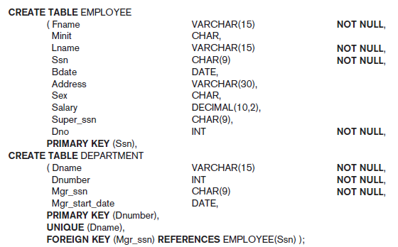
SELECT Statement - Example

Slide 16


SELECT Statement – Example
Query 0. Retrieve the birth date and address of the employee(s) whose name is ‘John B. Smith’.

Slide 17

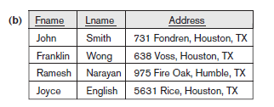
SELECT Statement – Example
Query 1. Retrieve the name and address of all employees who work for the ‘Research’ department.

Slide 18


SELECT Statement – Example
Query 2. For every project located in ‘Stafford’, list the project number, the controlling department number, and the department manager’s last name, address, and birth date.

Slide 19
Example2
Consider the following relation schema Works(Pname,Cname,salary), Lives(Pname,Street,City), located_in (Cname, city), Manager(Pname,Mgrname)
Write the SQL queries for the following
1. Create table Works.
2. Create table for Lives.
3. Find the names of all persons who live in the city Bangalore.
4. Retrieve the names of all person of "Infosys" whose salary is between Rs .50000 to Rs 100000.
5. Find the average salary of “Infosys” persons
Slide 8- <number>

Slide 20
Example2 - Solution
1. Create table Works.
CREATE TABLE Works (
Pname VARCHAR(100),
Cname VARCHAR(100),
salary DECIMAL(10, 2)
);
2. Create table for Lives.
CREATE TABLE Lives (
Pname VARCHAR(100),
Street VARCHAR(100),
City VARCHAR(100)
);
Slide 8- <number>

Slide 21
Example2 - Solution
3. Find the names of all persons who live in the city Bangalore.
SELECT Pname
FROM Lives
WHERE City = 'Bangalore';
4. Retrieve the names of all person of "Infosys" whose salary is between Rs .50000 to Rs 100000.
SELECT Pname
FROM Works
WHERE Cname = 'Infosys' AND salary BETWEEN 50000 AND 100000;
Slide 8- <number>

Slide 22
Example2 - Solution
5. Find the average salary of “Infosys” persons
SELECT AVG(salary) AS average_salary
FROM Works
WHERE Cname = 'Infosys';
Slide 8- <number>

Slide 23
Discuss the entity integrity and referential integrity constraints
Entity integrity constraint
The entity integrity constraint states that no primary key value can be NULL.
This is because the primary key value is used to identify individual tuples in a relation. Having NULL values for the primary key implies that we cannot identify some tuples.
Entity integrity constraints are specified on individual relations.

Slide 24
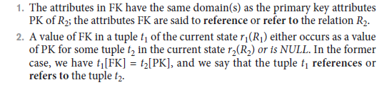
Discuss the entity integrity and referential integrity constraints
Referential integrity constraints
Consider the two relation schemas R1 and R2. A set of attributes FK in relation schema R1 is a foreign key of R1 that references relation R2 if it satisfies the following rules:
In this definition, R1 is called the referencing relation and R2 is the referenced relation. If these two conditions hold, a referential integrity constraint from R1 to R2 is said to hold.

Slide 25
What do you mean by terms Aggregation and Generalization? Explain it with the help of example
Aggregation is an abstraction concept for building composite objects from their component objects.
Three cases:
The first case is the situation in which we aggregate attribute values of an object to form the whole object.
The second case is when we represent an aggregation relationship as an ordinary relationship.
The third case involves the possibility of combining objects that are related by a particular relationship instance into a higher-level aggregate object.
Example: The class COMPANY is an aggregation of the attributes Cname (company name) and Caddress (company address), whereas JOB_APPLICANT is an aggregate of Ssn, Name, Address, and Phone.

Slide 26
What do you mean by terms Aggregation and Generalization? Explain it with the help of example
Generalization to refer to the process of defining a generalized entity type from the given entity types.
For example, consider the entity types CAR and TRUCK shown in Figure 4.3(a). Because they have several common attributes, they can be generalized into the entity type VEHICLE, as shown in Figure 4.3(b).
Both CAR and TRUCK are now subclasses of the generalized superclass VEHICLE.

Slide 27
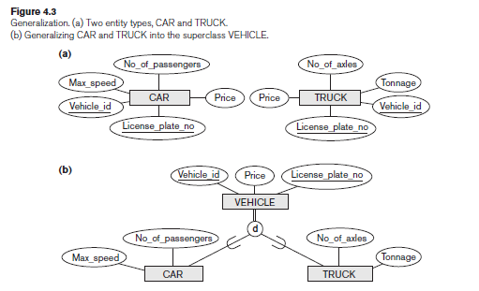
What do you mean by terms Aggregation and Generalization? Explain it with the help of example

Slide 28
ALTER TABLE
Used to add an attribute to one of the base relations
  The new attribute will have NULLs in all the tuples of the relation right after the command is executed; hence, the NOT NULL constraint is not allowed for such an attribute
Example:
ALTER TABLE EMPLOYEE ADD JOB VARCHAR(12);
The database users must still enter a value for the new attribute JOB for each EMPLOYEE tuple.
  This can be done using the UPDATE command.
Slide 8- <number>

Slide 29
INSERT
In its simplest form, it is used to add one or more tuples to a relation
Attribute values should be listed in the same order as the attributes were specified in the CREATE TABLE command
Slide 8- <number>

Slide 30
INSERT (contd.)
Example:
  U1: INSERT INTO EMPLOYEE
  VALUES ('Richard','K','Marini', '653298653', '30-DEC-52',
  '98 Oak Forest,Katy,TX', 'M', 37000,'987654321', 4 )
An alternate form of INSERT specifies explicitly the attribute names that correspond to the values in the new tuple
  Attributes with NULL values can be left out
Example: Insert a tuple for a new EMPLOYEE for whom we only know the FNAME, LNAME, and SSN attributes.
  U1A: INSERT INTO EMPLOYEE (FNAME, LNAME, SSN)
  VALUES ('Richard', 'Marini', '653298653')
Slide 8- <number>

Slide 31
INSERT (contd.)
Important Note: Only the constraints specified in the DDL commands are automatically enforced by the DBMS when updates are applied to the database
  Another variation of INSERT allows insertion of multiple tuples resulting from a query into a relation
Slide 8- <number>

Slide 32
INSERT (contd.)
Example: Suppose we want to create a temporary table that has the name, number of employees, and total salaries for each department.
  A table DEPTS_INFO is created by U3A, and is loaded with the summary information retrieved from the database by the query in U3B.
  U3A: CREATE TABLE DEPTS_INFO
  (DEPT_NAME VARCHAR(10),
  NO_OF_EMPS INTEGER,
  TOTAL_SAL INTEGER);
  U3B: INSERT INTO DEPTS_INFO (DEPT_NAME, NO_OF_EMPS, TOTAL_SAL)
  SELECT DNAME, COUNT (*), SUM (SALARY)
  FROM DEPARTMENT, EMPLOYEE
  WHERE DNUMBER=DNO
  GROUP BY DNAME ;
Slide 8- <number>

Slide 33
INSERT (contd.)
Note: The DEPTS_INFO table may not be up-to-date if we change the tuples in either the DEPARTMENT or the EMPLOYEE relations after issuing U3B. We have to create a view (see later) to keep such a table up to date.
Slide 8- <number>

Slide 34
DELETE
Removes tuples from a relation
  Includes a WHERE-clause to select the tuples to be deleted
  Referential integrity should be enforced
  Tuples are deleted from only one table at a time (unless CASCADE is specified on a referential integrity constraint)
  A missing WHERE-clause specifies that all tuples in the relation are to be deleted; the table then becomes an empty table
  The number of tuples deleted depends on the number of tuples in the relation that satisfy the WHERE-clause
Slide 8- <number>

Slide 35
DELETE (contd.)
Examples:
  U4A: DELETE FROM EMPLOYEE
  WHERE LNAME='Brown’
  U4B: DELETE FROM EMPLOYEE
  WHERE SSN='123456789’
  U4C: DELETE FROM EMPLOYEE
  WHERE DNO IN (SELECT DNUMBER
  FROM DEPARTMENT
  WHERE DNAME='Research')
  U4D: DELETE FROM EMPLOYEE
Slide 8- <number>

Slide 36
UPDATE
Used to modify attribute values of one or more selected tuples
A WHERE-clause selects the tuples to be modified
An additional SET-clause specifies the attributes to be modified and their new values
Each command modifies tuples in the same relation
Referential integrity should be enforced
Slide 8- <number>

Slide 37
UPDATE (contd.)
Example: Change the location and controlling department number of project number 10 to 'Bellaire' and 5, respectively.
  U5: UPDATE PROJECT
  SET PLOCATION = 'Bellaire', DNUM = 5
  WHERE PNUMBER=10
Slide 8- <number>

Slide 38
UPDATE (contd.)
Example: Give all employees in the 'Research' department a 10% raise in salary.
  U6: UPDATE EMPLOYEE
  SET SALARY = SALARY *1.1
  WHERE DNO IN (SELECT DNUMBER
  FROM DEPARTMENT
  WHERE DNAME='Research')
In this request, the modified SALARY value depends on the original SALARY value in each tuple
  The reference to the SALARY attribute on the right of = refers to the old SALARY value before modification
  The reference to the SALARY attribute on the left of = refers to the new SALARY value after modification
Slide 8- <number>

